Slide 1

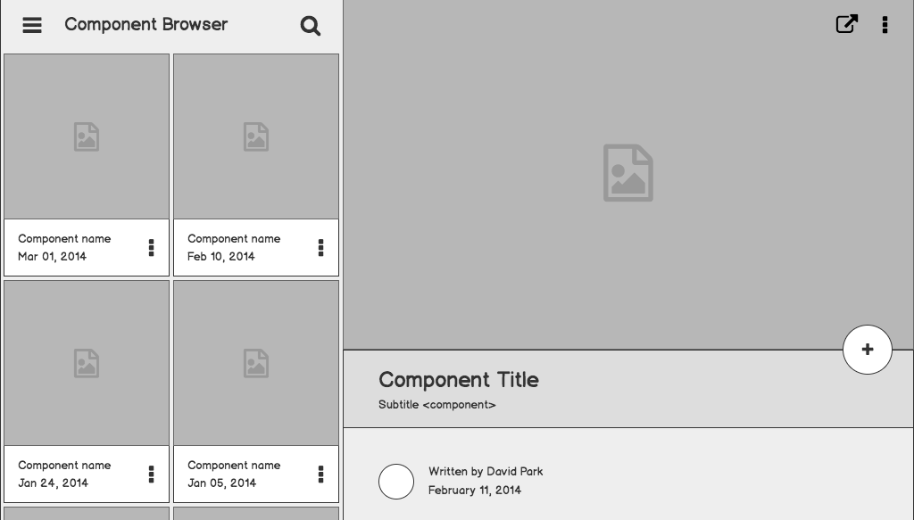

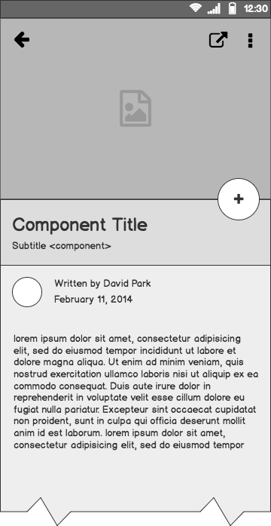
Smart Devices, are we ready?

Slide 2
Andres (Intro page)
The Problem
Solution Proposal
Wireframes
Next Steps

Slide 3
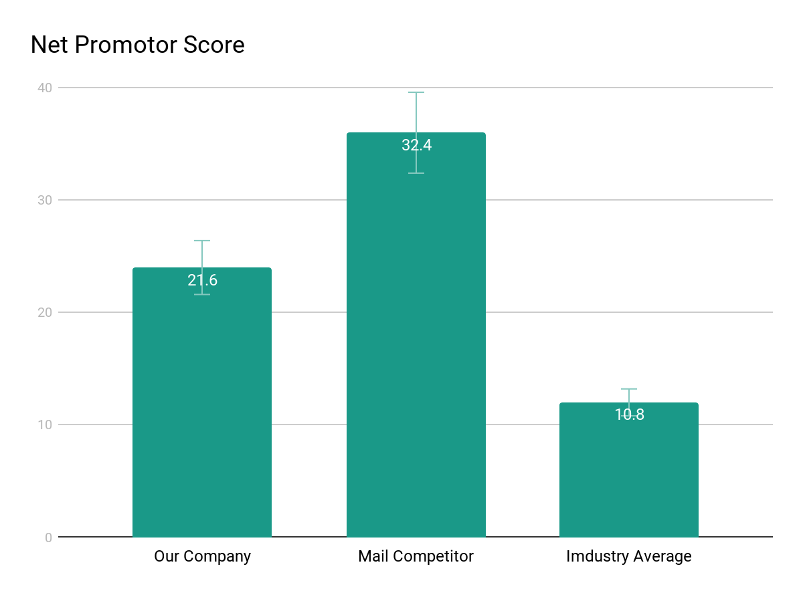
Supporting information
01
1
List any research or data you have to support the need for a solution.

Slide 4
Steph
(Intro page)
The Problem
Solution Proposal
Wireframes
Next Steps

Slide 5
Supporting information
02
82%
Users are constantly searching for a solution
Explain why you’re focusing on a particular part of the problem or a particular subset of users.

Slide 6
Cole
(Intro page)
The Problem
Solution Proposal
Wireframes
Next Steps

Slide 7
Supporting information
01
1
List any research or data you have to support the need for a solution.

Slide 8
Jake
(Intro page)
The Problem
Solution Proposal
Wireframes
Next Steps

Slide 9

Supporting information
03
Julia
Team Manager
Reference your personas, if you have them.
Describe the content of Julia’s job and the problem she and her team are currently facing.

Slide 10
What next?
Present the timeline.
Solicit comments on these slides or reviews on these wireframes in the Balsamiq add-on.
User testing plan.

Slide 11
Questions?

